Slide 1

Enhancing Loan Approval Processes through Predictive Modeling
Maddie Lee, Alexia Wells, Leah Ekblad, Whitney Holt
Notes:
Whitney - 1 min
“Hi everyone, my name is Whitney Holt and these are my teammates: Maddie Lee, Alexia Wells, and Leah Ekblad.
Today, we are excited to speak to you about the possibility of enhancing loan approval processes at Home Credit through predictive modeling.”

Slide 2
Introduction
Business Problem
Project Purpose
Overview
Notes:
Whitney - 1 min
“Before we jump in, I’d like to provide a overview of our presentation:
This presentation will cover
Business Problem
and subsequent Project Purpose
a promising Ensemble Model
related Business Implications
and some Potential Next Steps
Any remaining time will be used to answer Questions.”

Slide 3
Introduction
Business Problem
Project Purpose
Overview
Notes:
Whitney - 1 min
Business Problem:
“Financial institutions and lenders often use a customer’s credit history to approve loans and set interest rates.
Individuals that lack credit are often denied loans or are vulnerable to predatory lenders even if that individual is capable of repaying their loans.
This creates a loss of opportunity to both the borrower and creditor, which Home Credit seeks to overcome.”

Slide 4
Introduction
Business Problem
Project Purpose
Overview
Notes:
Whitney - 1 min
Purpose of this Project:
“This project aims to build a predictive model that evaluates loan repayment capability for individuals with limited or no traditional credit history.
A successful model will allow Home Credit to assess applicants based on alternative data, expanding credit access responsibly.”
“Now I’ll hand it over to Alexia, who will talk about our team’s Ensemble Model.”

Slide 5
Ensemble Model
Models
Random Forest
Bayesian Additive Trees
Logistic Regression
Extra Trees
Kaggle AUC: 0.70311
Runtime: 1.05 hours
Notes:
The best performing model was an ensemble method using stacking! This method included extra financial feature engineering. We combined predictions from four different models - random forest, BART, logistic regression and extra trees. This method is likely the highest performing because the individual models themselves were all high scoring on Kaggle between .69-.70. When combined with the meta-learner, which was a lasso penalized regression, the most important features were selected! The Kaggle score was 0.70311 and the runtime took 1.05 hours, using just 5% of the training data. It is possible that using the full dataset would cause for a higher Kaggle score, the downside is that it would certainly increase the model runtime. One way to decrease the runtime, would be to use servers to run the models. The final decision for how to implement everything would be up to the company based on their priorities.

Slide 6
Recommendation
Notes:
We believe Home Credit should implement the model as a secondary screening tool for applicants lacking traditional credit data

Slide 7
Recommendations
Evaluate
Performance
Scale
Implementation
Pilot
Notes:
The company should first pilot the model with a subset of applicants lacking credit scores.

Slide 8
Recommendations
Evaluate
Performance
Scale
Implementation
Pilot
Notes:
Then, evaluate performance against key metrics like approval rates, default rates, and customer feedback.

Slide 9
Recommendations
Evaluate
Performance
Scale
Implementation
Pilot
Notes:
And finally, scale implementation across all branches based on pilot results.
Next, Maddie will cover Business Implications.

Slide 10
Business Implications
Notes:
Thanks Alexia
Now that we have a recommendation on how to implement our model, let’s talk about the possible benefits

Slide 11
Expand Access to Credit
Notes:
Our model empowers Home Credit to expand its lending reach by identifying and approving loans for customers who lack traditional credit scores. This not only addresses the significant gap in access to credit but also supports financial inclusion, enabling Home Credit to responsibly grow its customer base by serving underserved markets.

Slide 12
Drive Revenue Growth
Notes:
With this model, Home Credit can increase loan approvals while maintaining rigorous risk standards. By unlocking access to untapped markets with high-potential borrowers, the company can drive significant revenue growth. This approach ensures that business expansion aligns with sustainable and responsible lending practices.

Slide 13
Maintain Risk Control
Notes:
Maintaining risk control is central to our approach. The model achieves a strong balance between increasing loan approvals and keeping default rates low. By leveraging predictive insights, Home Credit can identify low-risk borrowers, ensuring that growth is both profitable and sustainable

Slide 14
Enhance Competitive Advantage
Notes:
Implementing this model positions Home Credit as a leader in innovative and inclusive lending. It strengthens the company’s competitive advantage by aligning with fair lending practices and emphasizing customer-first strategies. This approach enhances brand equity and establishes Home Credit as a socially responsible and forward-thinking lender in the market.
I’ll pass it over to Leah, who will talk about next steps.

Slide 15
Looking Forward
Expand Application
Improve Computational Efficiency
Additional Features
Notes:
Leah - 1 min
“Thanks Maddie!”
“Looking forward, let’s discuss some potential next steps:
First, the team could explore additional features to include in the model such as transaction-level data or social determinants to further refine and improve predictions.”
Transaction-Level Data:
Transaction Amounts: The frequency and size of transactions (e.g., daily spending habits, large one-time purchases).
Transaction Categories: Types of purchases (e.g., groceries, entertainment, utilities), which could indicate financial behavior or lifestyle.
Payment Methods: Whether transactions are made using credit cards, debit cards, or digital wallets, which may reflect financial habits.
Merchant Information: Where transactions occur (e.g., high-end retailers vs. discount stores) could provide insights into a person's financial profile.
Transaction Recency/Frequency: How recently and how often a customer makes transactions, which could indicate financial stability or risk.
Transfer or Payment Patterns: Frequency of sending money to other accounts (e.g., remittances, peer-to-peer payments).
Debt Repayments: Regular payments on loans or credit card bills, indicating financial responsibility or strain.
Social Determinants:
Income Level: Household or individual income, a key factor in financial decision-making and risk assessment.
Education Level: Highest degree attained, which may correlate with financial literacy or earning potential.
Employment Status: Employment type (e.g., full-time, part-time, self-employed) and job stability, which influence financial health.
Neighborhood/Location: Geographic location or neighborhood, which can impact access to resources, job opportunities, and economic stability.
Family Structure: Household size, number of dependents, and marital status, which can affect financial priorities and risks.
Health and Disability Status: Health conditions or disabilities that can influence an individual's ability to work or manage finances.
Social Support Networks: Availability of financial or social support from family, friends, or community organizations.
Housing Stability: Whether the individual rents or owns, or if they've experienced housing insecurity, which could correlate with financial stability.

Slide 16
Looking Forward
Expand Application
Improve Computational Efficiency
Additional Features
Notes:
Leah- 1 min
“Second, the team could improve computational efficiency by reducing processing time, ultimately enabling the possibility of making credit decisions in real-time.”

Slide 17
Looking Forward
Expand Application
Improve Computational Efficiency
Additional Features
Notes:
Leah - 1 min
“Lastly, Home Credit may consider expanding the application of this model to other financial products, such as microloans or insurance, further unlocking even more business potential.”

Slide 18
QUESTIONS?
Notes:
Q&A - 1 min
Thank you all for joining, we will now open it up for any questions that you may have

Slide 19
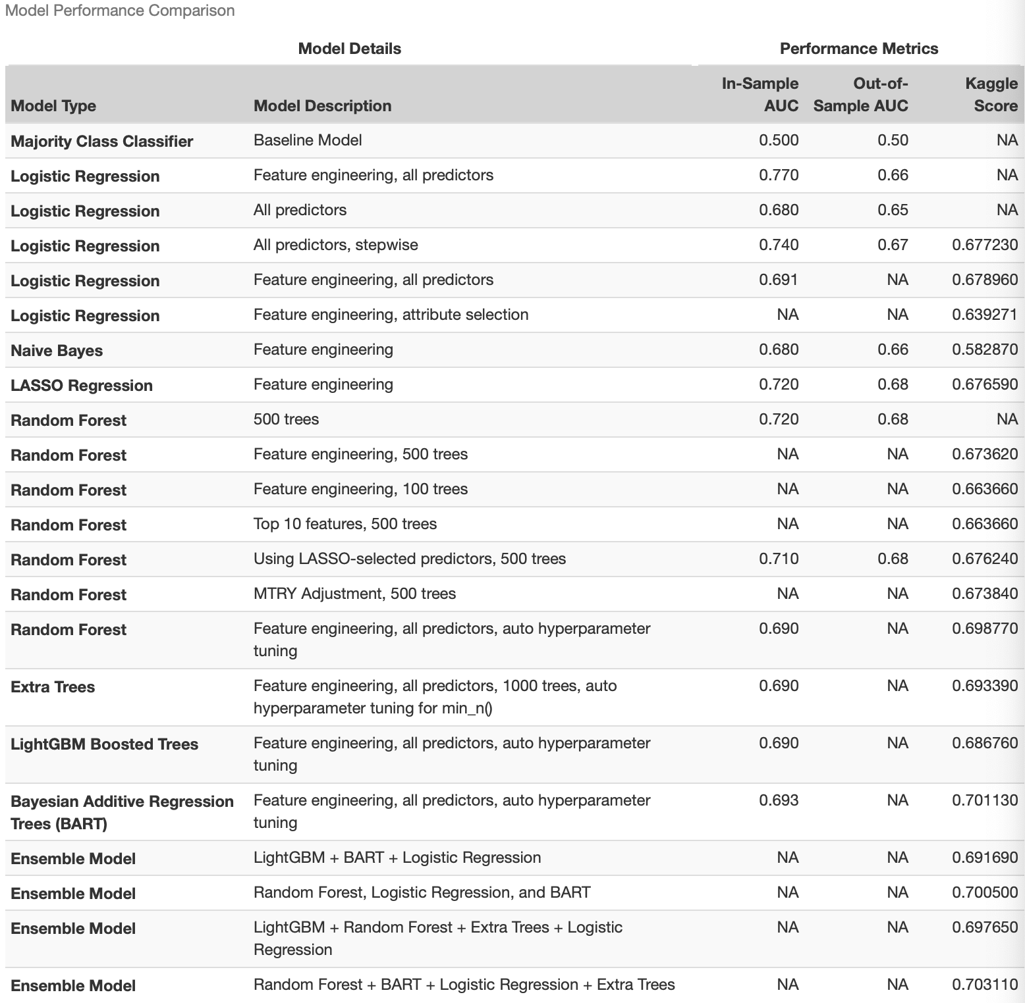
Appendix

Slide 20
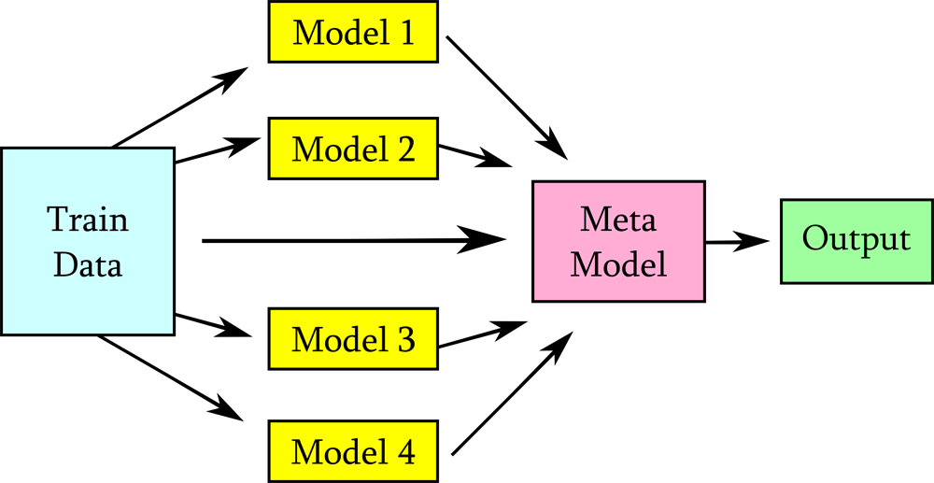
Appendix - Stacking Model Predictions
Goal - Reduce bias and improve predictions
Combines predictions of diverse models
Meta-learner that makes the final predictions
Notes:
The best performing model was an ensemble method using stacking! We tried this out because most of the top leaderboard submissions used this method. Essentially, you use several different models to train the data, put all of them into a meta model. Once that is done, you get the finalized predictions.

Slide 21
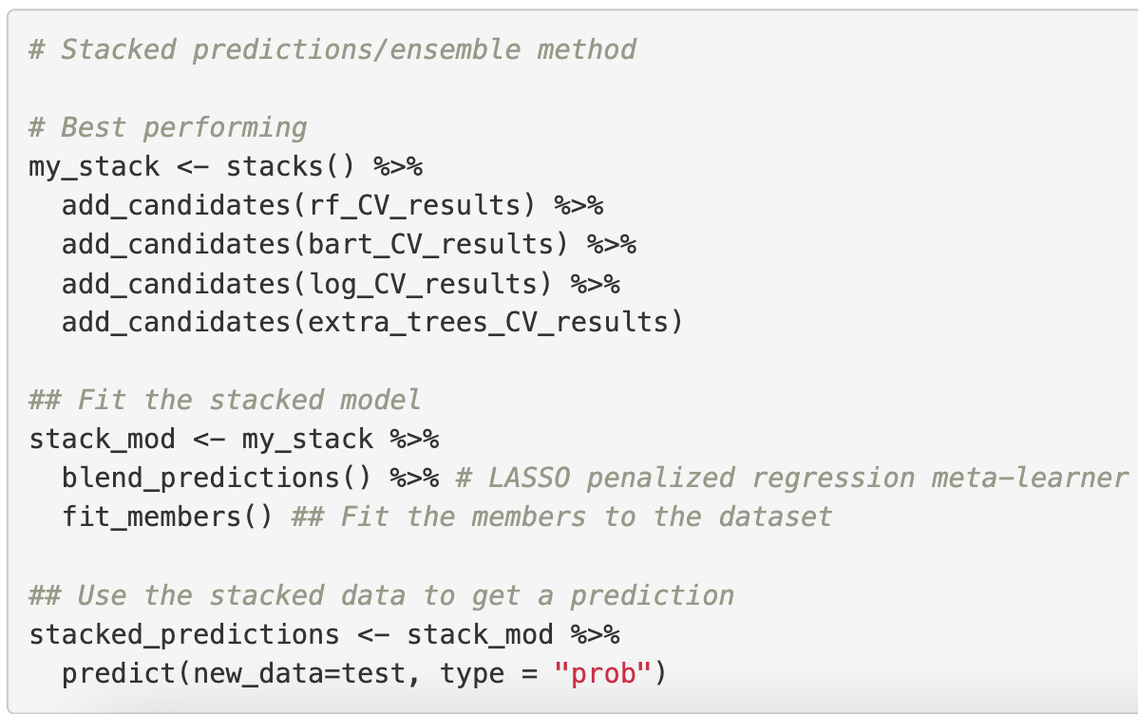
Appendix
Notes:
This is a quick look at what our code looked like. As you can see, you add all the models, and put it into a LASSO penalized regression metal-learner, which performs variable selection and reduces model complexity.

Slide 22
Appendix - Ensemble Model
Models Used
Random Forest - Bagging/boost strapping aggregating
Bayesian Additive Trees - Essentially looped boosting algorithm
Logistic Regression
Extra Trees - Bagging
Kaggle AUC: 0.70311
Runtime: 1.05 hours
Notes:
The best performing model was an ensemble method using stacking! This method included extra financial feature engineering from previous_application.csv. We combined predictions from four different models - random forest, BART, logistic regression and extra trees. This method is likely the highest performing because the individual models themselves were all high scoring on Kaggle between .699-.701. When combined with the meta-learner, which was a lasso penalized regression, the most important features were selected! The Kaggle score was 0.70311 and the runtime took 1.05 hours, using just 10% of the training data. It is possible that using the full dataset would cause for a higher Kaggle score.
Models Used
Random Forest - Bagging/boost strapping aggregating
Bayesian Additive Trees - Essentially looped boosting algorithm
Logistic Regression
Extra Trees - Bagging
Kaggle AUC: 0.70311
Runtime: 1.05 hours

